Slide 1

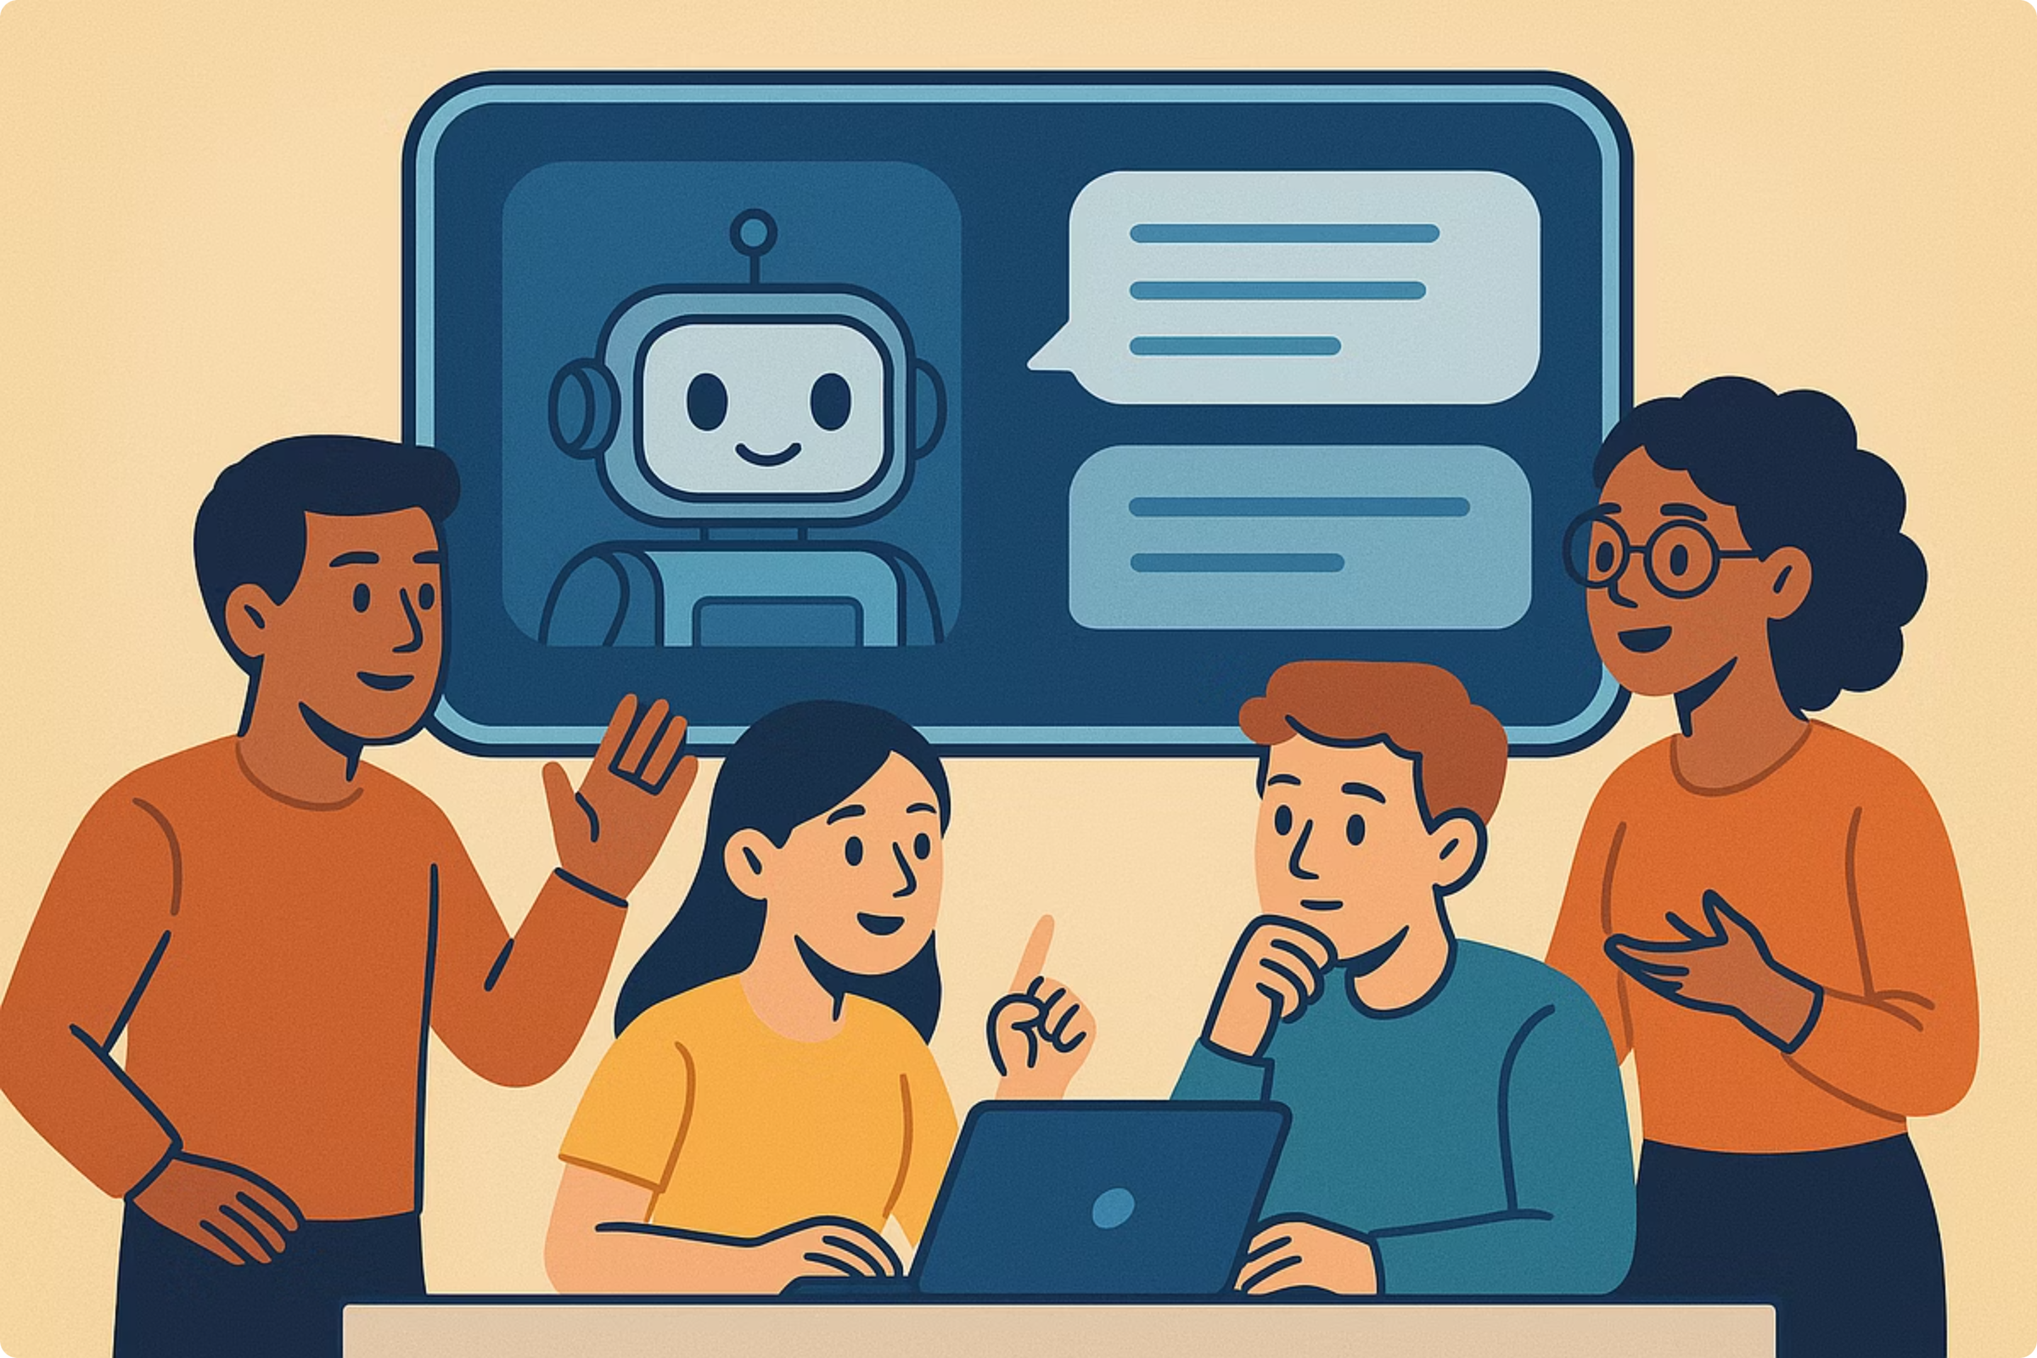
Generative AI Chatbots for Student Doubt Solving: Revolutionizing Learning Support
Transforming how students find answers and deepen understanding.

Slide 2
The Growing Need for Instant, Personalized Student Support
Surge in AI Tutoring Adoption
24/7 Accessibility & Cost-Effectiveness
Overcoming Hesitation
Many students hesitate to ask questions in class. Chatbots provide an anonymous, low-pressure environment for immediate, private assistance.
Over 1 million K-12 students are already using AI tutoring tools like Khanmigo, signaling a massive shift in learning support.
Traditional tutoring is often limited by availability and cost, while AI offers constant, affordable access to help, anytime, anywhere.

Slide 3
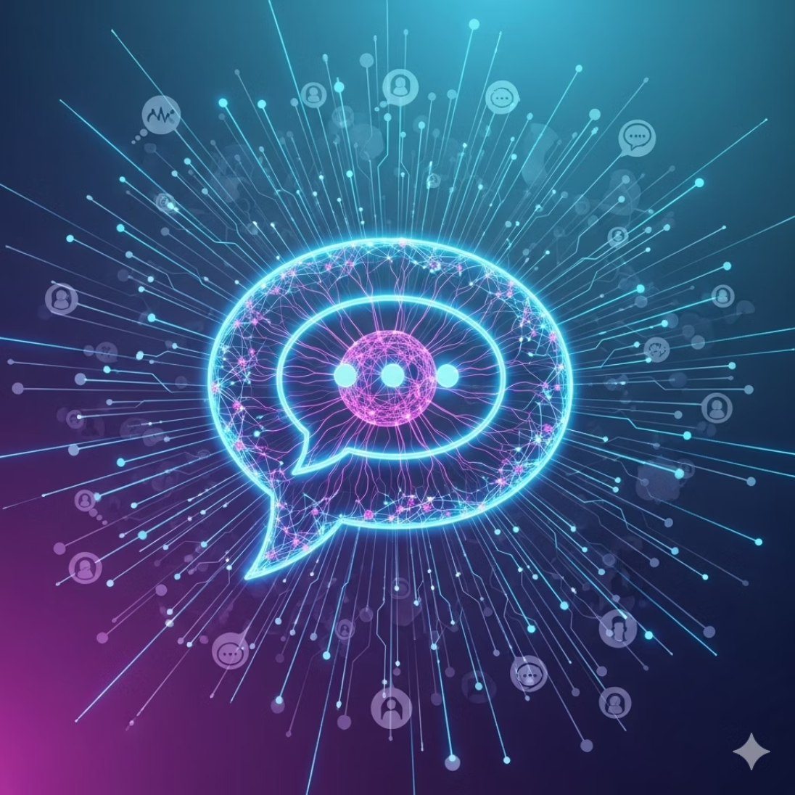
What Are Generative AI Chatbots?
Generative AI chatbots are sophisticated conversational agents powered by large language models (LLMs) that leverage deep learning techniques.
They are designed to simulate human-like conversation, enabling them to:
Answer complex questions
Explain challenging concepts
Guide students through learning processes
Examples in Education:
ChatGPT’s Study Mode
Google Gemini’s Guided Learning
Anthropic’s Claude tutor

Slide 4




AI as a Tutor, Mentor, and Coach: Multifaceted Educational Roles
Generative AI chatbots can play diverse and complementary roles in a student's learning journey:
Tutor
Mentor
Provides personalized explanations, uses analogies, and applies Socratic questioning to build foundational skills.
Offers immediate, formative feedback on written essays, coding attempts, and complex problem-solving approaches.
Coach
Teammate
Supports metacognitive reflection, helping students analyze their thought processes and improve study habits.
Acts as a collaborative partner for brainstorming, creative tasks, and joint problem-solving scenarios.

Slide 5
Evidence of Effectiveness: Enhancing Creative Problem Solving
Recent research highlights the significant impact of AI chatbots on student learning outcomes:
Knowledge-Based Dialogue: A 2025 study with 80 postgraduates revealed that AI chatbots fostered richer, more knowledge-based discussions compared to peer interactions.
User-Friendliness: Students found AI tutors intuitive and highly useful for tackling complex academic tasks.
Improved Performance: Practical performance in creative problem-solving significantly improved among students who interacted with chatbots.

Slide 6

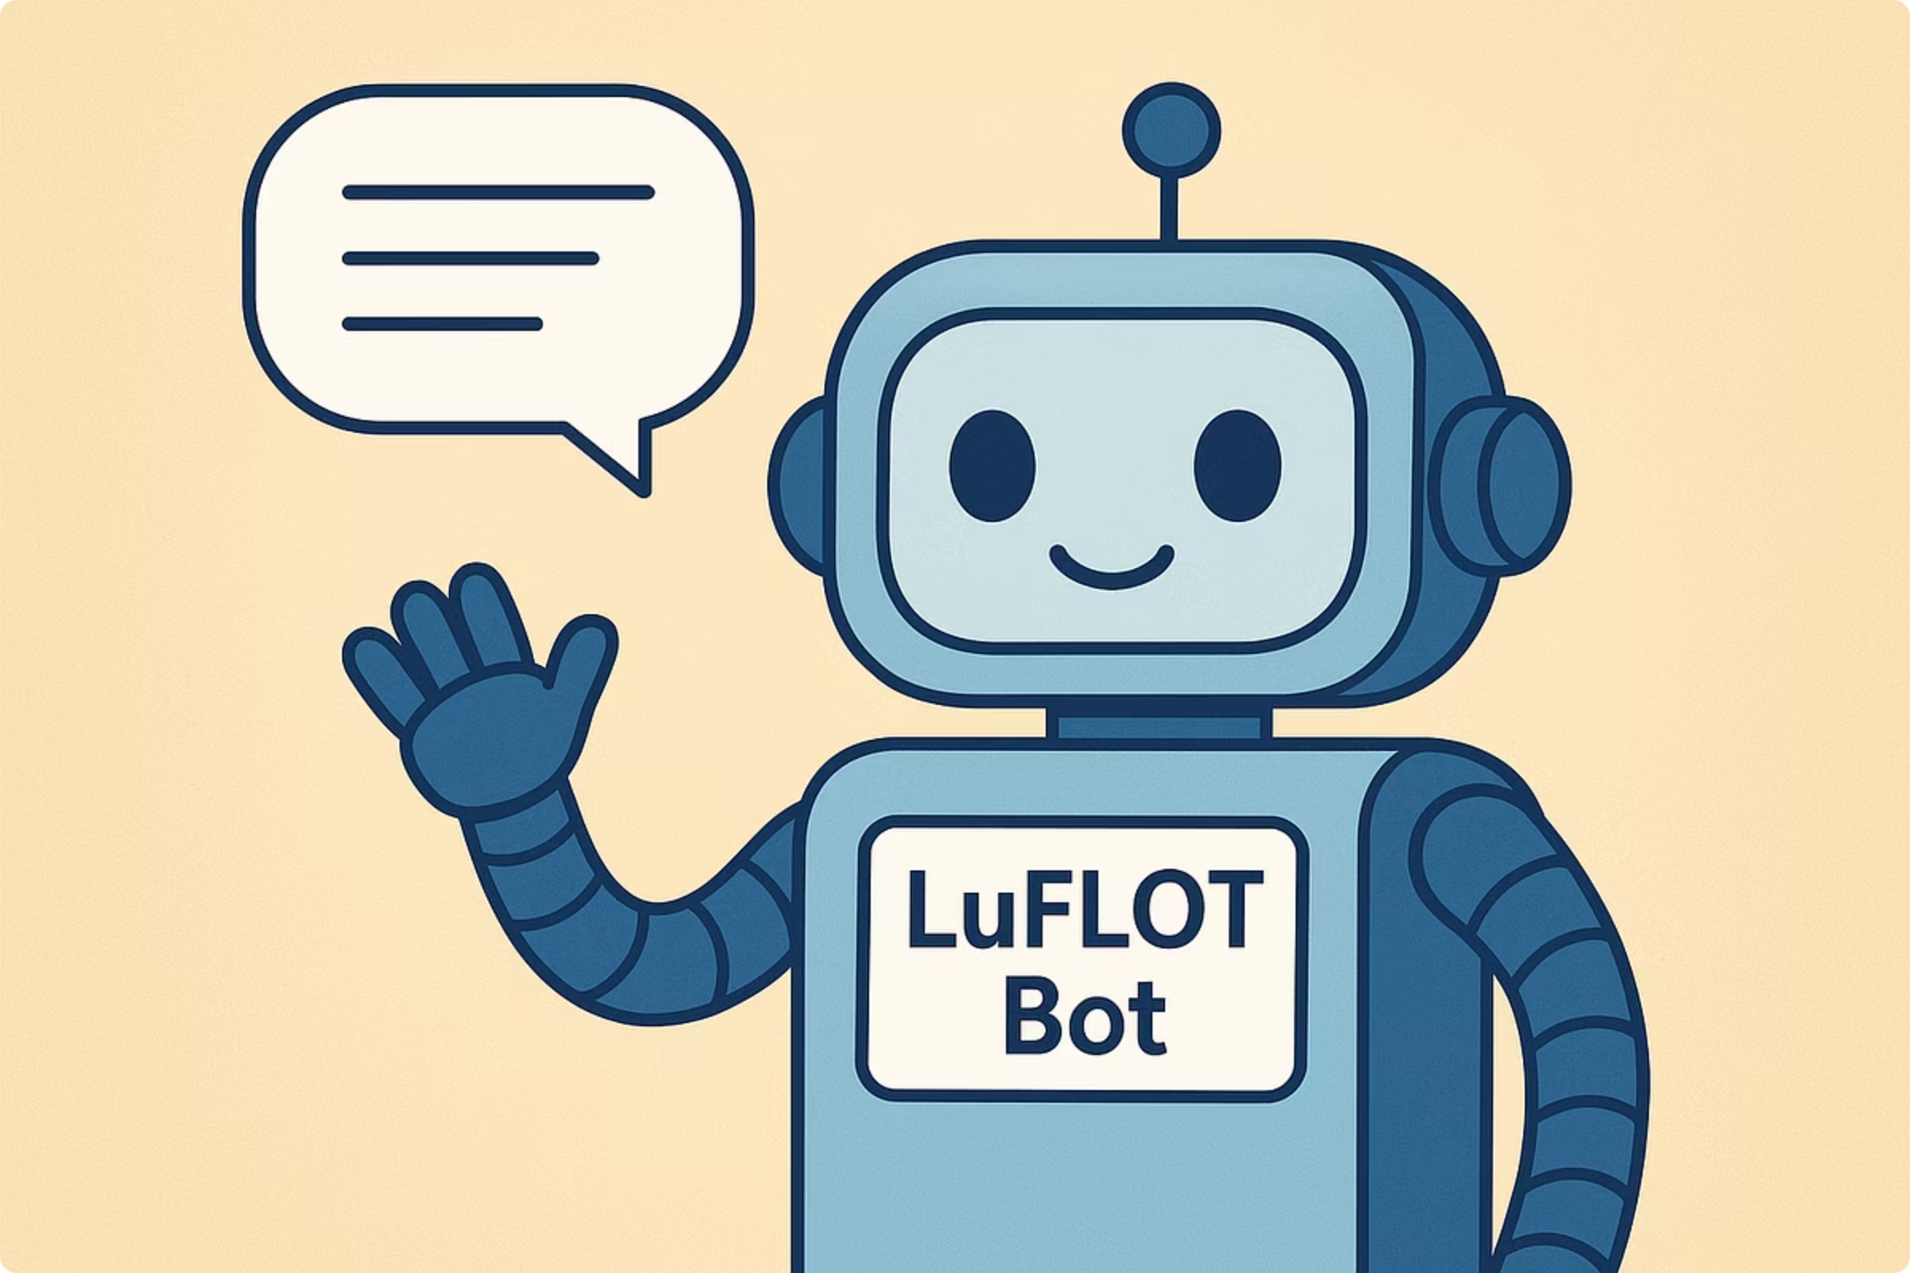
Real-World Success Story: Yale’s LuFlot Bot
Yale University developed "LuFlot Bot," an AI chatbot trained on the works of philosopher Luciano Floridi. This innovative tool aims to democratize access to complex philosophical ideas, making them understandable and accessible to a wider audience.
Provides detailed, accurately cited answers.
Encourages critical engagement with ethical AI topics.
Demonstrates the power of domain-specific chatbots to deepen student understanding in specialized academic fields.

Slide 7
How Students Use AI Chatbots for Doubt Solving Today
Students are creatively integrating AI chatbots into their study routines:
Practice & Quizzing
Personalized Explanations
Generate customized practice questions and quizzes on confusing topics to reinforce learning.
Receive step-by-step explanations and tailored study plans that adapt to individual learning paces and needs.
Blended Learning
Socratic Guidance
Combine AI tools with traditional resources like textbooks and teacher insights for a comprehensive and balanced learning approach.
Leverage features like ChatGPT’s Study Mode, which uses the Socratic method to guide students toward answers rather than just providing them.

Slide 8

Challenges and Considerations
While promising, the integration of AI chatbots presents several challenges:
Over-reliance & Academic Integrity: Risk of students becoming overly dependent on AI, necessitating clear guidelines to uphold academic integrity.
Accuracy & Bias: AI-generated answers require critical evaluation for potential inaccuracies or inherent biases.
Subject Limitations: Not all academic subjects or types of questions are equally well-supported by current AI tutors.
Assignment Revision: Educators must revise assignments to encourage authentic learning and discourage misuse of AI.

Slide 9




Best Practices for Integrating AI Chatbots in Education
Foster Trust & Clarity
Introduce AI tools with positive framing and clear academic integrity policies from the outset.
Encourage Purposeful Use
Guide students to use chatbots for doubt clarification, skill practice, and conceptual understanding, not just for answers.
Promote Critical Engagement
Advise students to use AI feedback as a starting point for deeper critical thinking, revision, and independent problem-solving.
Educator Empowerment
Provide training for educators to effectively assess, integrate, and guide the responsible use of AI in their classrooms.

Slide 10
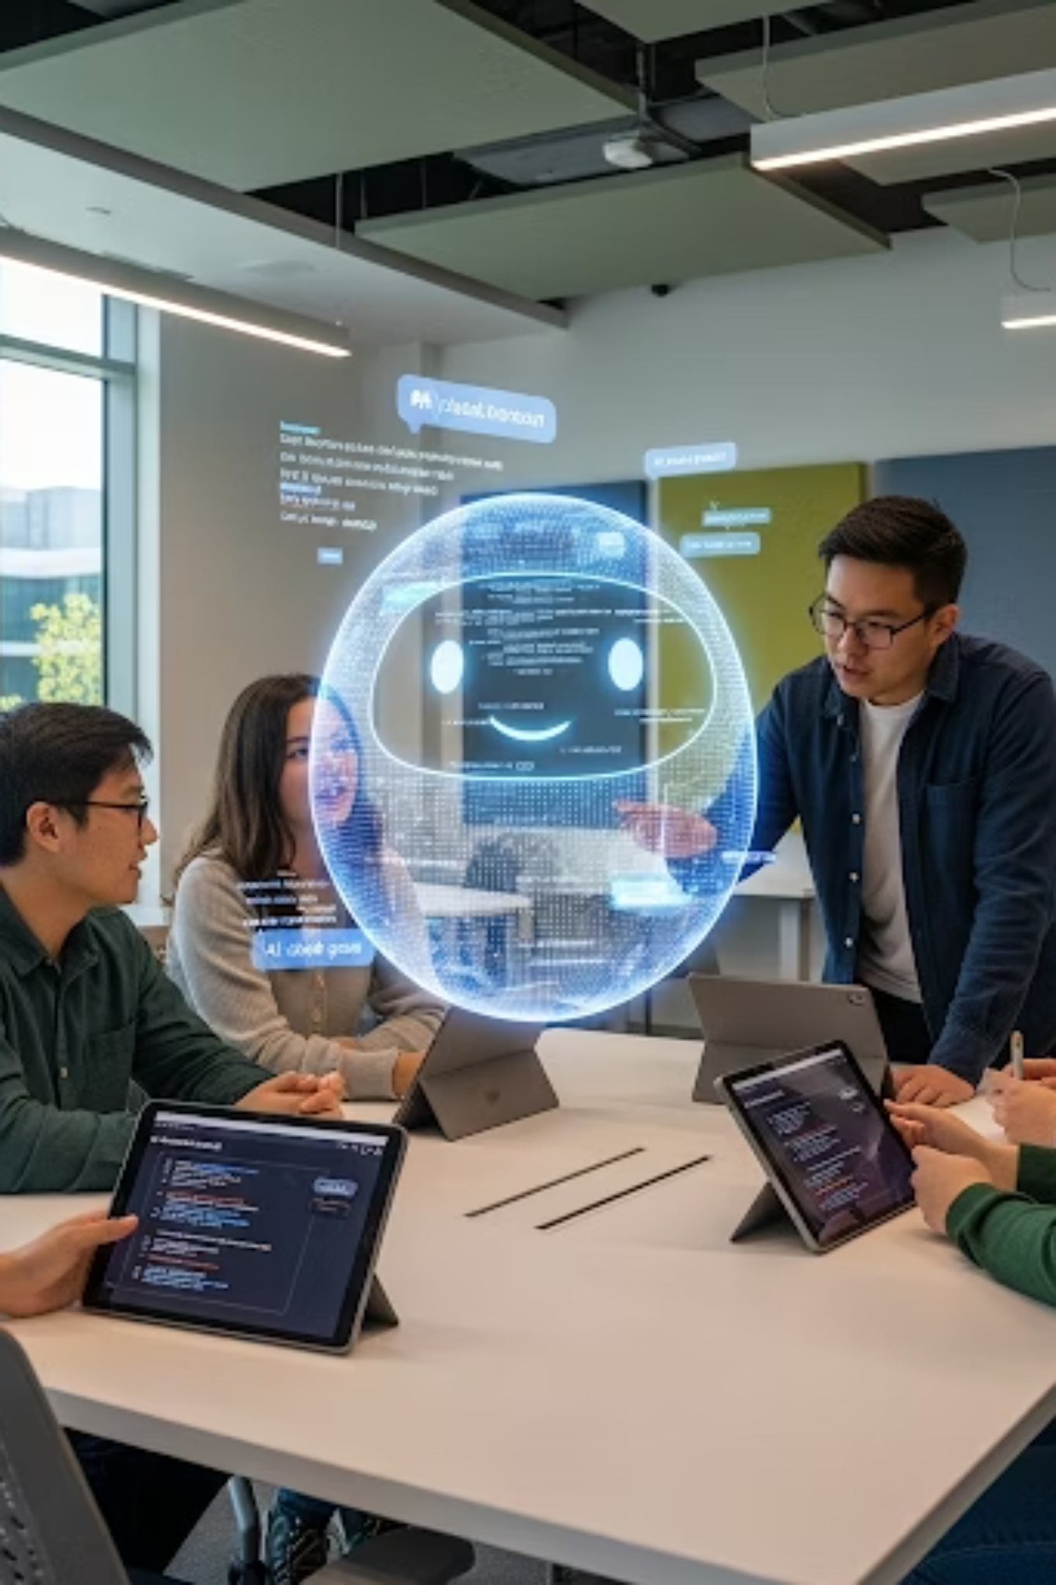
The Future of Student Doubt Solving with AI Chatbots
The landscape of student support is poised for transformative change:
Increasing Adoption: Expect widespread integration and sophistication of AI tutors across all educational levels.
Personalized Learning at Scale: AI holds immense potential to individualize learning experiences and significantly reduce achievement gaps.
Ongoing Research: Continuous validation of impact and optimization of chatbot design will refine their effectiveness.
Embrace AI chatbots as partners in empowering student learning journeys.

